Slide 1
Enabling Ontology-based Access to Streaming Data Sources
OEGTalks
Jean-Paul Calbimonte¹, Oscar Corcho¹, Alasdair J G Gray²
¹Ontology Engineering Group. Departamento de Inteligencia Artificial.
Facultad de Informática, Universidad Politécnica de Madrid.
Campus de Montegancedo s/n. 28660 Boadilla del Monte. Madrid. Spain
jp.calbimonte@upm.es;ocorcho@fi.upm.es
²School of Computer Science, The University of Manchester,
Oxford Road, Manchester M13 9PL, United Kingdom
a.gray@cs.man.ac.uk

Slide 2
Outline
Introduction & Motivation
Background
Approach
Mapping Streams to Ontologies
SPARQL Stream
Query Translation
Example
Future work
Conclusions

Slide 3
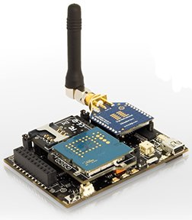
Introduction & Scope
Sensor technologies
Ubiquitous data capture
Data processing
Cheap
Noisy, Unreliable
Low computational, power resources, storage
Streaming Data
Continuously appended data
Potentially infinite
Time-stamped tuples
Continuous queries
Latest used in queries
(t9, a1, a2, ... , an)
(t8, a1, a2, ... , an)
(t7, a1, a2, ... , an)
...
...
(t1, a1, a2, ... , an)
...
...
Streaming Data
Applications in security surveillance, healthcare provision, environmental monitoring, you name it.

Slide 4
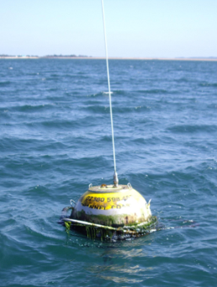
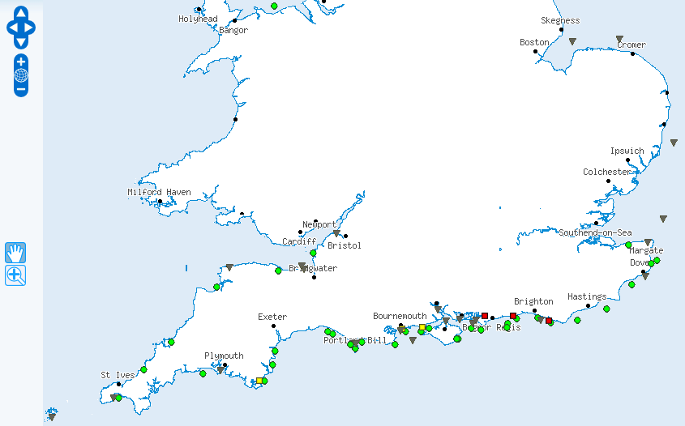




Motivation
Flood risk alert:
South East England
Wave,
Wind,
Tide
Real-time
data
Emergency planner
Meteorological forecasts
Flood defences data
Other sources
...
...
...
Detect conditions likely to cause a flood
Present data model in terms of the user domain: e.g. Flood risk assessment
Example:
“provide me with the wind speed observations average over the last minute in the Solent region, if it is higher than the average of the last 2 to 3 hours”

Slide 5
Motivation
Ontologies can be used as such a common model
Answer the requirements:
Establish mappings between ontological models and streaming data source schemas
Access streaming data sources through queries over ontology models

Slide 6
Background – Ontology-based Data Access
Generate Semantic Web content from existing relational data sources
Ontological Models
R₂O + ODEMapster
D2RQ
SquirrelRDF
RDBToOnto
Relational.OWL
SPASQL
Virtuoso
MASTRO
e.g. SPARQL
Query/Data Transformation
Mapping
Document
Ontology-based Data Access
e.g. SQL
Relational
Schemas

Slide 7
Background – Querying Relational Data Streams
Streaming Data
Event Streams
Acquisitional Streams
STREAM
Aurora/Borealis
Cougar
TinyDB
SNEE
Query engines
e1
WINDOW [t_{now} TO t_{now-2}]
SLIDE 1
e1
e2
CQL
SNEEql
TinyQL
Query languages
e1
e2
e3
Transform infinite sequence of tuples to bounded bag
e1
e2
e3
e4
t
t+1
t+2
t+3
t+4
t+5
Window-to-Stream operators: convert stream of windows to stream of tuples
...
...

Slide 8
Ontology-based Streaming Data Access
q
Query
translation
SPARQL_{Sream} algebra(S₁ S₂ S_{m})
Sensor Network (S₁)
SPARQL_{Sream} (O_{g})
Query Evaluator
Relational DB (S₂)
Client
Stream-to-Ontology
mappings
Stream Engine (S₃)
RDF Store (S_{m})
Data
translation
[tuples]
[triples]
Ontology-based Streaming Data Access Service

Slide 9
Ontology-based Streaming Data Access
Mappings from relational streams to ontological concepts
Extend stored data schema mappings
Study translation semantics
Provide with a stream query language at ontological level
Use notion of RDF stream
Extend SPARQL
Window operator, window-to-stream operators

Slide 10
SPARQL_{Stream}
Example:
“provide me with the wind speed observations over the last minute in the Solent Region ”
STREAM <http://www.semsorgrid4env.eu/ccometeo.srdf>
cd:Observation
...
...
( <ssg4e:Obs1,rdf:type, cd:Observation>, t_{i} ),
( <ssg4e:Obs1,cd:observationResult,”34.5”>, t_{i} ),
( <ssg4e:Obs2,rdf:type, cd:Observation>, t_{i+1} ),
( <ssg4e:Obs2,cd:observationResult,”20.3”>, t_{i+1} ),
...
...
cd:observationResult
xsd:double
RDF-Stream
...
...
( <s_{i-1},p_{i-1}, o_{i-1}>, t_{i-1} ),
( <s_{i}, p_{i}, o_{i}>, t_{i} ),
( <s_{i+1},p_{i+1}, o_{i+1}>, t_{i+1} ),
...
...

Slide 11
SPARQL_{Stream}
Example:
“provide me with the wind speed observations over the last minute in the Solent Region ”
PREFIX cd: <http://www.semsorgrid4env.eu/ontologies/CoastalDefences.owl#>
PREFIX sb: <http://www.w3.org/2009/SSN-XG/Ontologies/SensorBasis.owl#>
PREFIX rdf: <http://www.w3.org/1999/02/22-rdf-syntax-ns#>
SELECT ?windspeed ?windts
FROM STREAM <http://www.semsorgrid4env.eu/ccometeo.srdf>
[ NOW – 1 MINUTE TO NOW – 0 MINUTES ]
WHERE
{
?WindObs a cd:Observation;
cd:observationResult ?windspeed;
cd:observationResultTime ?windts;
cd:observedProperty ?windProperty;
cd:featureOfInterest ?windFeature.
?windFeature a cd:Feature;
cd:locatedInRegion cd:SolentCCO.
?windProperty a cd:WindSpeed.
}
cd:Observation
cd:observationResult
cd:observedProperty
xsd:double
cd:Property
cd:featureOfInterest
cd:Feature
cd:locatedInRegion
cd:Region

Slide 12
Ontology-based Streaming Data Access
q
Query
translation
SPARQL_{Sream} algebra(S₁ S₂ S_{m})
Sensor Network (S₁)
SPARQL_{Sream} (O_{g})
Query Evaluator
Relational DB (S₂)
Client
Stream-to-Ontology
mappings
Stream Engine (S₃)
RDF Store (S_{m})
Data
translation
[tuples]
[triples]
Ontology-based Streaming Data Access Service

Slide 13
S2O Mappings
R2O Mappings
Schema descriptions (probably mostly unused)
<has-table name="raingauge">
<keycol-desc name="id"/>
<keycol-desc name="ts"/>
<nonkeycol-desc name="level"/>
</has-table>
<has-stream name="windsamples" streamType="push">
<keycol-desc name="id"/>
<keycol-desc name="ts"/>
<timestamp-desc name="ts" />
<nonkeycol-desc name="speed"/>
<nonkeycol-desc name="temperature"/>
<nonkeycol-desc name="direction"/>
</has-stream>

Slide 14
S2O Mappings
<conceptmap-def id="Observation_wind"
name="http://www.semsorgrid4env.eu/ontologies/CoastalDefences.owl#Observation"
virtualStream="http://www.semsorgrid4env/ccometeo.srdf">
<uri-as>
<operation oper-id="concat">
<arg-restriction on-param="string1">
<has-value>http://www.semsorgrid4env.eu/data#ObservationWind</has-value>
</arg-restriction>
<arg-restriction on-param="string2">
<has-column>meteostream.DateTime</has-column>
</arg-restriction>
</operation>
</uri-as>
<attributemap-def
name="http://www.semsorgrid4env.eu/ontologies/CoastalDefences.owl#observationResult"
dataType="xsd:double">
<selector>
<aftertransform>
<operation oper-id="constant">
<arg-restriction on-param="const-val">
<has-column>meteostream.Hs</has-column>
</arg-restriction>
</operation>
</aftertransform>
</selector>
</attributemap-def>
cd:Observation
meteostream
cd:observationResult
Datetime: long
Hs : float
Lon: float
Lat: float
xsd:double

Slide 15
S2O Mappings
Union of extents-streams
envdata_rhylflats
Datetime: long
Hs : float
Lon: float
Lat: float
U
envdata_milford
<union name="meteostream">
<map value="http://www.semsorgrid4env.eu/ontologies/
CoastalDefences.owl#SolentCCO">
<extent name="envdata_hornsea"></extent>
<extent name="envdata_rhylflats"></extent>
<extent name="envdata_milford"></extent>
<extent name="envdata_westbay"></extent>
</map>
</union>
cd:Observation
Datetime: long
Hs : float
Lon: float
Lat: float
U
cd:observationResult
envdata_hornsea
Datetime: long
Hs : float
Lon: float
Lat: float
xsd:double
U
envdata_westbay
Datetime: long
Hs : float
Lon: float
Lat: float

Slide 16
Ontology-based Streaming Data Access
SPARQL_{Sream} algebra
q
Query
translation
SNEEql
Sensor Network (S₁)
SPARQL_{Sream} (O_{g})
Query Evaluator
Relational DB (S₂)
Client
Stream-to-Ontology
mappings
Stream Engine (S₃)
RDF Store (S_{m})
Data
translation
[tuples]
[triples]
Ontology-based Streaming Data Access Service

Slide 17
Stored Data Query Translation
Translation
SELECT ?y
FROM STREAM < STREAM
<http://www.semsorgrid4env.eu/ccometeo.srdf>
[ NOW – 1 MINUTE TO NOW – 0 MINUTES ] >
WHERE
{ ?x a cd:Observation;
cd:observationResult ?y. }
SELECT concat( ‘ssg4env.eu#ObservationWind' ,
envdata_milford.datetime ) as x,
FROM envdata_milford [ FROM NOW - 1 TO NOW MIN]
SELECT concat( ‘ssg4env.eu#ObservationWind' ,
envdata_milford.datetime ) as x,
envdata_milford.Hs as y
FROM envdata_milford [ FROM NOW - 1 TO NOW MIN]
Redundant queries, unacceptable for stream processing

Slide 18

Query Translation
Queries:
SELECT ?y
WHERE
{ ?x a cd:Observation;
cd:observationResult ?y. }
SELECT ?y
FROM STREAM < STREAM <http://www.semsorgrid4env.eu/ccometeo.srdf>
[ NOW – 1 MINUTE TO NOW – 0 MINUTES ] >
WHERE
{ ?x a cd:Observation;
cd:observationResult ?y. }
Notes:
q(x)\leftarrow Observation(x) \wedge observationResult(x,y)\\
q(\vec{x})\leftarrow \phi(\vec{x},\vec{y}))
\mathit{\Psi \leadsto \Phi}

Slide 19

Query Translation
Mappings:
query
algebra expression over sources
cd:Observation
envdata_milford
cd:observationResult
Datetime: long
Hs : float
Lon: float
Lat: float
xsd:double
Datetime
Hs
envdata_milford
Notes:
(Observation(x) \wedge \\observationResult(x,y))[t_i,t_f,\delta]\\

Slide 20
Query Translation
envdata_rhylflats
Datetime: long
Hs : float
Lon: float
Lat: float
U
cd:Observation
envdata_milford
Datetime: long
Hs : float
Lon: float
Lat: float
cd:observationResult
U
xsd:double
envdata_hornsea
Datetime: long
Hs : float
Lon: float
Lat: float
DateTime
Hs
U
envdata_westbay
Datetime: long
Hs : float
Lon: float
Lat: float
DateTime
Hs
DateTime
Hs
DateTime
Hs
DateTime
Hs
envdata
_rhylflats
envdata
_milford
envdata
_hornsea
envdata
_westbay

Slide 21
Ontology-based Streaming Data Access
SPARQL_{Sream} algebra
q
Query
translation
SNEEql
Sensor Network (S₁)
SPARQL_{Sream} (O_{g})
Query Evaluator
Relational DB (S₂)
Client
Stream-to-Ontology
mappings
Stream Engine (S₃)
RDF Store (S_{m})
Data
translation
[tuples]
[triples]
Ontology-based Streaming Data Access Service

Slide 22
Query Execution
v
Ontologies
Feature
envdata_westbay
Streams
envdata_chesil
locatedInRegion
v
Observation
v
hasObservationResult
S₂O
Mapping
envdata_milford
v
observedProperty
Region
envdata_hornsea
xsd:float
envdata_rhylflats
WaveHeightProperty
Timestamp: long
Hs : float
Lon: float
Lat: float
PREFIX cd: <http://www.semsorgrid4env.eu/ontologies/CoastalDefences.owl#>
PREFIX sb: <http://www.w3.org/2009/SSN-XG/Ontologies/SensorBasis.owl#>
PREFIX rdf: <http://www.w3.org/1999/02/22-rdf-syntax-ns#>
SELECT ?waveheight ?wavets ?lat ?lon
FROM STREAM <http://www.semsorgrid4env/ccometeo.srdf>
WHERE
{
?WaveObs a cd:Observation;
cd:observationResult ?waveheight;
cd:observationResultTime ?wavets;
cd:observationResultLatitude ?lat;
cd:observationResultLongitude ?lon;
cd:observedProperty ?waveProperty;
cd:featureOfInterest ?waveFeature.
?waveFeature a cd:Feature;
cd:locatedInRegion cd:SouthEastEnglandCCO.
?waveProperty a cd:WaveHeight.
}
(SELECT Lon,timestamp,Hs,Lat FROM envdata_rhylflats) UNION
(SELECT Lon,timestamp,Hs,Lat FROM envdata_hornsea) UNION
(SELECT Lon,timestamp,Hs,Lat FROM envdata_milford) UNION
(SELECT Lon,timestamp,Hs,Lat FROM envdata_chesil) UNION
(SELECT Lon,timestamp,Hs,Lat FROM envdata_perranporth) UNION
(SELECT Lon,timestamp,Hs,Lat FROM envdata_westbay) UNION
(SELECT Lon,timestamp,Hs,Lat FROM envdata_pevenseybay)
SPARQL_{Stream}
SNEEql

Slide 23
Ontology-based Streaming Data Access
SPARQL_{Sream} algebra
q
Query
translation
SNEEql
Sensor Network (S₁)
SPARQL_{Sream} (O_{g})
Query Evaluator
Relational DB (S₂)
Client
Stream-to-Ontology
mappings
Stream Engine (S₃)
RDF Store (S_{m})
Data
translation
[tuples]
[triples]
Ontology-based Streaming Data Access Service

Slide 24
Data Translation
Data translation:
Tagged tuples → SPARQL bound variables
<ns9:sparql>
<ns9:head>
<ns9:variable name="waveheight"/>
<ns9:variable name="wavets"/>
</ns9:head>
<ns9:results>
<ns9:result>
<ns9:binding name="waveheight">
<ns9:literal datatype="http://www.w3.org/2001/XMLSchema#double">4.850</ns9:literal>
</ns9:binding>
<ns9:binding name="wavets">
<ns9:literal datatype="http://www.w3.org/2001/XMLSchema#long">1272588663</ns9:literal>
</ns9:binding>
</ns9:result>
<ns9:result>
<ns9:binding name="waveheight">
<ns9:literal datatype="http://www.w3.org/2001/XMLSchema#double">2.1230</ns9:literal>
</ns9:binding>
<ns9:binding name="wavets">
<ns9:literal datatype="http://www.w3.org/2001/XMLSchema#long">1272587400</ns9:literal>
</ns9:binding>
</ns9:result>
</ns9:results>
</ns9:sparql>

Slide 25
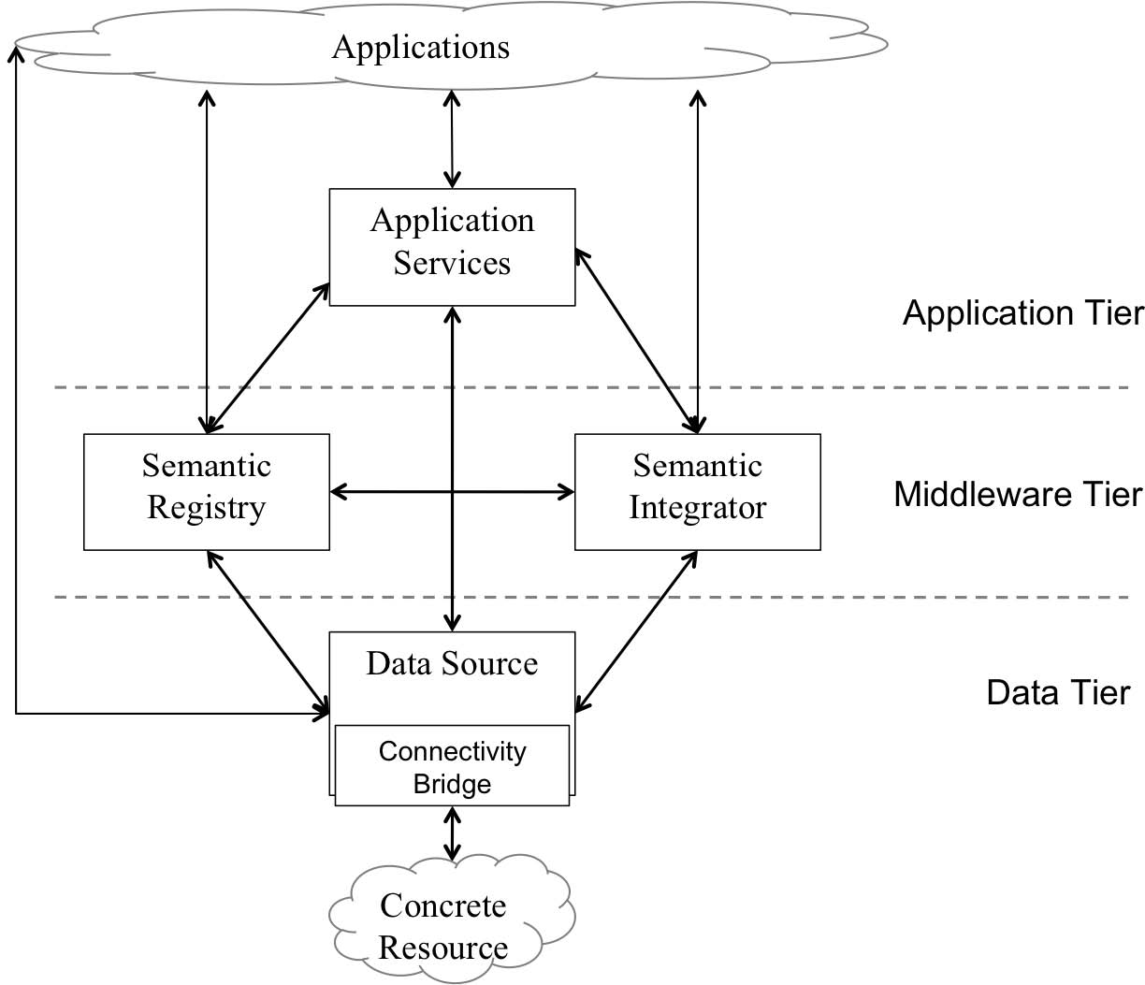
Implementation
Design, implement and deploy a Semantic Integration Service
Extend existing ontology-based data integration models to take into account sensor networks streaming data, semantic heterogeneity and quality of service

Slide 26
Implementation
S2O
mappings
repository
Integration
Query Service
Translator
IntegrationInterface
CCO-WS
SNEE-WS
QueryInterface
Client
SNEEql
PullInterface
IntegrateAs (DataResourceAddressList, S2O document)
DataResourceAddress
SPARQLQueryFactory (DataResourceName, SPARQL_{STR} )
addQuery
DataResourceAddress
GetStreamNewestItem(DataResourceName )
repeat
getResultSet
DataSet

Slide 27
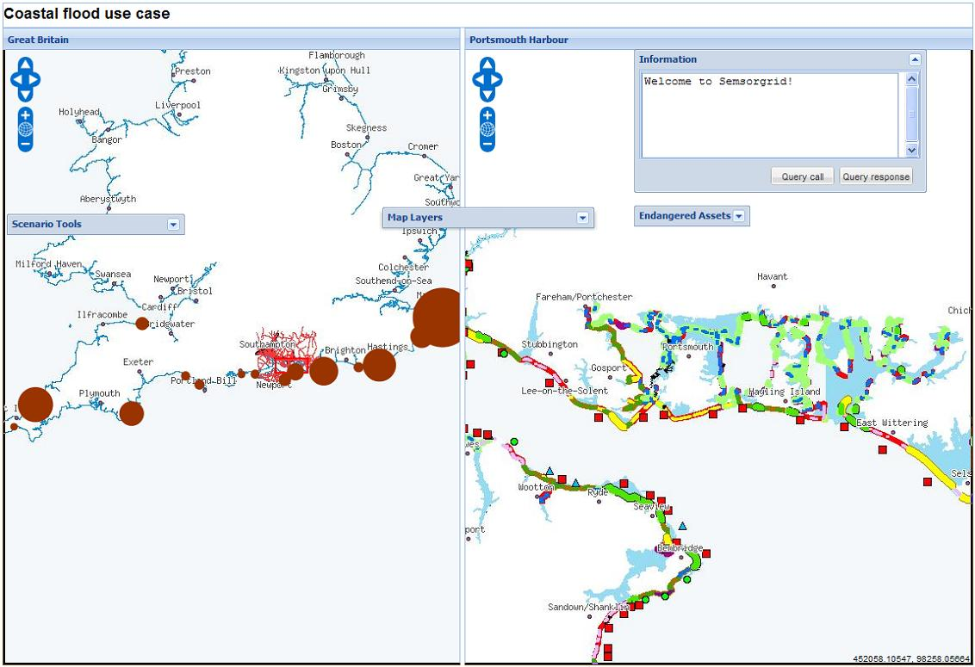
Implementation
Flood Warning Application

Slide 28
So Far…
Ontology-base data access
Define stream extensions for R2O
Define SPARQL_{Stream} language syntax and semantics
Define S2O mappings-based translation semantics
Implementation
Enable engine support for « S2O » documents, SPARQL_{Stream} queries
Enabled engine support for SNEEql translation and connection
Limited to non-distributed scenario initially

Slide 29
Future Works
Ontology-based data access
SPARQL construct expressions, aggregates, projected operators
Implement adapters for other streaming sources
Add query rewriting algorithms
Ontology-based streaming data integration
Horizontal & vertical integration
Integrate streaming + stored data
RDF data sources integration
Streaming query optimization
Analyze cost models
Streaming sources statistics and metadata
Quantitative evaluation
29

Slide 30
Thanks!
Enabling Ontology-based Access to Streaming Data Sources

Slide 31

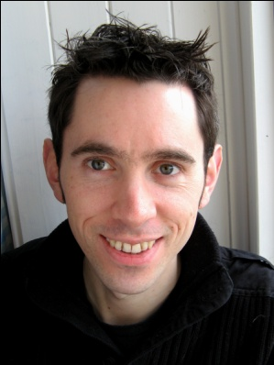
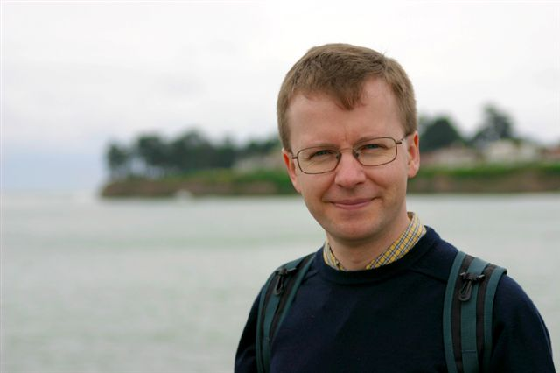

Internship
Period: 21.05.2010 - 29.07.2010
Institution: School of Computer Science, The University of Manchester
Research contact: Alasdair Gray
Professors:
Norman Paton,
Alvaro Fernandes

Slide 32
Objectives
Study the existing approaches on distributed SPARQL query processing.
Study the existing SPARQL query optimization approaches.
Study the existing streaming SPARQL query processing approaches.
Propose a coherent solution for streaming distributed query processing using SPARQL extensions.
Propose a study use-case in the context of the SSG4E project that highlights the streaming query processing capabilities.
Prepare a formal publishable version of the proposal for the consideration of the community

Slide 33
Research Outcome
Stuff for each of the objectives available in draft documents:
http://delicias.dia.fi.upm.es/wiki/index.php/ManchesterJPC
Material in development for future interesting work

Slide 34
Integration Use-cases
Horizontal integration of data sources. Sources provide the same type of information with respect to the global schema. The data may overlap (redundancy) or be complementary (partitioned) and it can be seen as union of homogeneous information.
Vertical integration of sources. Sources provide different information with respect to the global schema. In this case data of each source adds additional information to an original set. In this case the joins are between different kinds of information and finding their relationships is not always straightforward.
Integration of different streaming sources. Answer queries including data from 2+ streaming sources.
Integration of streaming and stored data.
Integration of streaming data in the past and current streaming data

Slide 35
Completing SPARQL_{Stream}
Adjust semantics of « triple-based » windows
Fixes on types: stream of triples, stream of triple windows.
Window-to-Stream operation semantics
Stored data scans

Slide 36
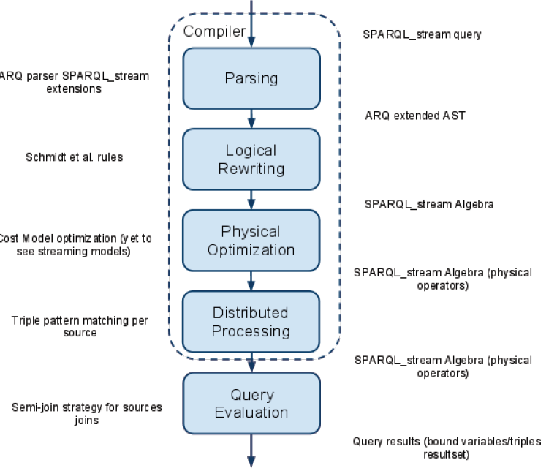
Query Optimization

Slide 37
Open for Collaboration
Any streaming data in your project? e.g. geo information?
Mapping-based query translation
Distributed query processing
Discovery/invocation of data sources
Others…

Slide 38
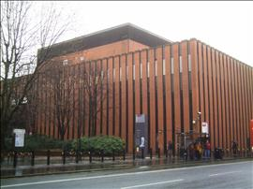

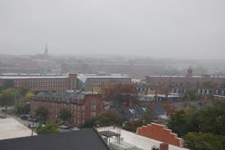
Thanks

